Slide 1

UNIFIED BOARD
Baltimore-Washington Conference of the
United Methodist Church
Training Tuesday, January 14, 2020
Rev. Dr. Johnsie W. Cogman, Presenter

Slide 2
Introduction
Various Names
Unified Board
Single Board
One Board
Notes:
Various names meaning the same thing.

Slide 3

Tell us about your unified board experience by answering 3 easy questions
Notes:
3 Question Poll (Bill Brown will incorporate)
Question 1
My church uses the Unified Board Model already. Answers: Yes or No
Question 2
I have a leadership role in the following areas.
Answer choices (check all that apply):
Church/Admin Council
Lay Leader
Lay Member to AC
Trustee
Finance
SPRC
Pastor
Question 3
I frequently attend meetings for my church:
Answer choices (Check only one)
Once a week
2-3 times a week
Once a month
2-3 times a month

Slide 4
HUMAN OBJECTIVE
Open our eyes, ears & heart to new things
Listen and Learn to Launch
Ask questions for clarification!

Slide 5

Academic Objective
Discover
Discover how your structure will better support your church’s mission & Vision with minimized time and effort.
Honor
Honor the Book of Discipline while streamlining decision making so that more time can be spent in hands-on ministry.
Explore
Explore a variety of approaches to creating a different type of Administration Council. Learn what it is, how to effectively implement it.
Answer
Answer any questions for clarity and implementation.

Slide 6

Structure Should Align
Church Around Vision & Mission
Accountability
Authority
Teamwork
Notes:
What is the mission of the United Methodist Church?
What is your church’s Mission and Vision?

Slide 7

Mission-Driven Leadership
The mission of the church comes first
Those responsible are accountable
Must have the right people in place to accomplish the mission
Small number of decision makers – large number of people in ministry
Laity driven, not the pastor(s)

Slide 8
Board-Led / Mission-Driven Leadership
Lots of input – very focused direction
Pastor evaluates the board and provides input
Everyone is held accountable for the mission
Alignment to the mission and vision is critical!

Slide 9
Accountable Leadership
UNIFIED BOARD = Role is governing
Pastor = Role is leading
Staff (paid & unpaid) = Role is managing
Members = Role is ministering
Notes:
The senior pastor is called to lead the church.
The board supports and reports to the Senior Pastor (not the congregation) and is responsible for managing the church and carrying out the implementation of the vision. The pastor holds the board accountable for achieving their goals and provides support and training where needed.
The board/council holds the pastor accountable for achieving goals and protects them from things that would get in the way of achieving those goals. They protect the pastor from people or things that would negatively impact the achievement of goals, vision, and mission.
The Congregation does the ministry of the church.
The next slides show a good example.

Slide 10
Accountable Leadership
Position | Players | Functions | Metaphors
Leadership | Pastor | Vision casting, directing and teaching | Head coach, or quarterback, captain, etc…
Governance | Board | Accountability and support | Commissioner, umpire, scorekeeper & cheerleader
Ministry | Members | Reaching out first then caring for one another | Teammates, champions, athletes, etc…
Management | Staff (paid & unpaid) | Equipping and coordinating | Assistant coaches and specialists

Slide 11
Accountable Leadership Strengths
Marries responsibility and authority with accountability
Promotes church unity
Functions on a high level of trust
Decisions are made very quickly
Mission/Vision fulfillment is the driving force…not management or maintenance
Goals and objectives of ministries can be adjusted as needed

Slide 12

Pastor’s Role
Spiritual Leader/Shepherd
Mission Keeper
Vision Caster
Servant Evangelist
Stewardship Captain
Reaching Recruiter
Develops Leaders (Staff, Board, New Leaders)
Notes:
All of the roles change as we move toward accountability leadership. It is important for us to be clear on what we are asking our pastor to focus on in our church.

Slide 13
Structure
Structure = the design and arrangement of tangible factors in time and space.
Forms of Structure:
Budgets / Finances
Calendar
Facility / Buildings

Slide 14
Structure & Changing Generations
Post WWII – Baby Boomers – Gen X – Millennials …
The WAY we do church is changing
Attendance vs membership
Minimal Meetings
Committees to Teams
Notes:
Attendance now includes in person and on-line.
Meetings are kept to a minimum and are effective and efficient.
A team works together for one common goal.

Slide 15
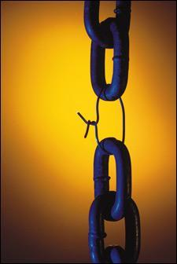
Problem with Many Structures
Promotes disunity and enables dysfunction
Clear lines of authority…but no clear lines of accountability
All responsibility on the pastor, but has little or no authority
Nearly impossible to make difficult and timely decisions

Slide 16
Ex. of Problems with
Many Structures
Inward Focus
Anarchy
Notes:
Let’s take a look at some of the problems that occur in churches now due to ineffective structures.

Slide 17
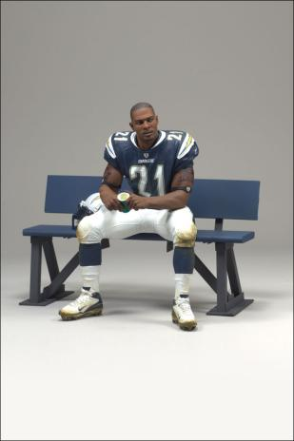
Problem with Many Structures
Inward Focus
Hard to win if you’re not in the game
Notes:
The Great Commission, to make disciples, is displaced by other good pursuits.
Putting the desires of insiders first leads to divisions based on opposing special interest groups.
In the absence of biblical mission, the congregation suffers a lack of vision.

Slide 18

Problem with Many Structures
Anarchy
Hard to win if no one is sure who’s picking the plays
Notes:
When we aim at nothing in particular, that’s what we hit.
Movements seeking to restore “New Testament Christianity” often overlook cultural and missional contextualization in both the first and twenty-first centuries.
Lack of intentional structure will facilitate the path of least resistance, which is inward focus.
Even with an outward focus by intention, a ministry without structure is unlikely to make much impact.

Slide 19
There is another way . . .
UNIFIED Board Model

Slide 20

Alternative Structure…
UNIFIED BOARD
The alternative structure is based on ¶247.2 of the 2016 Book of Discipline:
The charge conference, the district superintendent, and the pastor shall organize and administer the pastoral charge and churches according to the policies and plans herein set forth. When the membership size, program scope, mission resources, or other circumstances so require, the charge conference may, in consultation with and upon the approval of the district superintendent, modify the organizational plans, provided that the provisions of ¶ 243 are observed.

Slide 21
Book of Discipline ¶247.2
¶247.2 The Charge Conference, district superintendent and the pastor shall organize and administer the pastoral charge and churches according to the policies and plans herein set forth. When the membership size, program scope, mission resources or other circumstances so require, the charge conference may, in consultation with and upon the approval of the district superintendent, modify the organizational plans, provided that the provisions of ¶243 are observed.
Notes:
Membership size
Program scope
Mission resouces

Slide 22
Book of Discipline ¶243
Primary Task: Make disciples of Jesus Christ for the transformation of the world
Basic Responsibilities
  Nurture, Outreach, and Witness
  Effective pastoral and lay leadership
  Financial support, facilities and legal obligations of the church
  Appropriate relationships & resources of the district and annual conference
  Creating, maintaining and sharing records
  Seeking inclusiveness in all aspects of its life

Slide 23
Book of Discipline ¶244 Named Entities
A charge conference
A church council
A committee on pastor-parish relations
A board of trustees
A committee on finance
A committee on nominations and leader development
Notes:
BOD Para 244 – Organization
Every local church shall develop a plan for organizing it’s administrative and programmatic responsibilities.

Slide 24
Supporting & Improving Grassroots Ministry
From being Disconnected to being Coordinated
From Reporting to Dreaming & Deciding
From Many on Committees to Many in Ministry

Slide 25
Responsibilities & Tasks
Establish the church’s yearly budget
Confirm the vision cast by the pastor and establish yearly goals for the church
Work in partnership with programs and ministries to ensure they fulfill the mission and vision of the church
Work with the District Superintendent to hold the pastor accountable
*This team is not responsible for hearing reports. Other avenues for communication (bulletins, email, Facebook, newsletters, Town Hall meetings, etc…) within the congregation must be efficiently employed.

Slide 26
Unified Board – Basic Administration
F1
F2*
T1*
T2
F3
T3
SP
LM
CC*
KEY
F=Finance
T=Trustees
S=SPRC (one of SPRC folks is Lay Leader)
SP=Senior Pastor
LM + LM to annual conference
CC = Church Council Chair
*= Chairperson
The numbers represent “classes”
S1
S2
S3*
Notes:
Unified Board is made up of key leaders that have a daily understanding of what’s happening on the frontlines of ministry.
To transition from three independent committees to one operations team, the following guidelines may be important

Slide 27
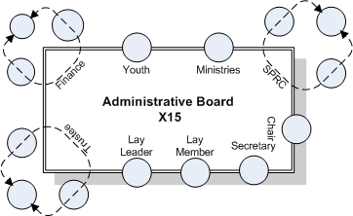
Enhanced Unified Board
Accountable to Charge Conference
Leaders shall be nominated by Lay Leadership Development
Concerned with administration and general church oversight
Transparency through publishing minutes, open attendance, time in the meeting for open forum, ability for members to bring issues to the Board
Meets monthly
Notes:
Note: Only ONE person represents all the ministries in the church.

Slide 28
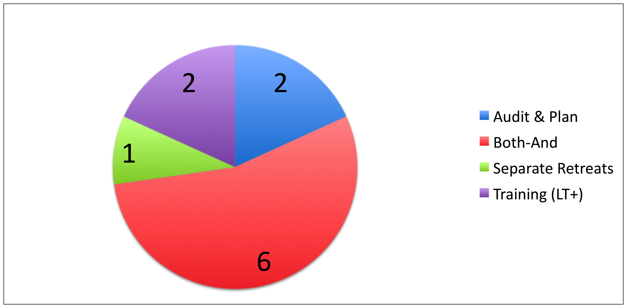
Yearly Meeting Formats

Slide 29
Unified Board
Evaluates and Makes Decisions that
Impact Deployment of Resources to Achieve our Mission
Improve the Ability of Those on the Front-Line to Fulfill our Purpose
4 of the 11 Meetings are Strategic in Nature
2x/year for audit & planning
2x/year for training/equipping/dreaming—with others invited depending upon topic
Remaining Meetings are More Tactical in Nature

Slide 30
Both-And
Weeknight Format
6:30-9:30
Meeting begins with Study and Prayer
Administry and Discipleship Conversations
Decisions & Discussions that Impact All
Closing Prayer

Slide 31
Both-And
Weekend Format
9:00am – 12:30pm
Gathers for Study and Prayer
Administry and Discipleship
Decisions & Discussions that Impact All
Closing Prayer

Slide 32
Policies and Further Work Needed
Manual on how the leadership structure functions
Clear roles, duties, and descriptions for each position
Policies on confidentially
Change management/transition planning

Slide 33
A Governing Body
Sets Boundaries
Budgets,
Policies
Goals
Values
Oversight
NOT DAY-TO-DAY OPERATIONS OF THE CHURCH
Notes:
Two Challenges of a Governing Board
Decision Making – Accuracy / Effectiveness
Management of Communication
Communication / Feedback loops
become very important –
Everyone is used to hearing
everything in committee meetings
New Leadership Agenda
1/3 = Spiritual Formation, Leadership Development, review of new people/families
1/3 = Deal with pressing decisions/issues, help groups as needed
1/3 = Review goals / Accountability and reallocation of assets

Slide 34
Two Challenges of a Governing Body
Decision Making – Accuracy / Effectiveness
Management of Communication
  Communication / Feedback loops become very important
  Everyone is used to hearing everything in committee meetings
  “The way we used to to do it…”
Notes:
New Leadership Agenda
1/3 = Spiritual Formation, Leadership Development, review of new people/families
1/3 = Deal with pressing decisions/issues, help groups as needed
1/3 = Review goals / Accountability and reallocation of assets

Slide 35
Top 5 Mistakes
Not clarifying key departure points from current operations.
    Managing versus Governing
    Reporting versus Discussing/Deciding
    Representing versus Shared Mission
Under-communicating with those who feel displaced
No orientation or transition plan.
Hyperfocus on tasks above relationships.
Not waiting for right people.

Slide 36
Structure May Be Holding You Back If There Is…
A replication of efforts,
Poor teamwork,
Lack of focus on mission field,
Weak strategic alignment,
A slow pace of innovation,
Poor morale

Slide 37

Relationships are VITAL #teamwork

Slide 38
Rev. Dr. Johnsie W. Cogman jcogman@bwcumc.org

