Slide 1
Family Ministries
Erica Benjamin
Director of Children’s Ministries
Severna Park UMC
Ebenjamin@SevernaParkUMC.org

Slide 2
Deuteronomy 6:4-9
Hear, O Israel: The Lord is our God, the Lord alone. You shall love the Lord your God with all your heart, and with all your soul, and with all your might. Keep these words that I am commanding you today in your heart. Recite them to your children and talk about them when you are at home and when you are away, when you lie down and when you rise. Bind them as a sign on your hand, fix them as an emblem on your forehead, and write them on the doorposts of your house and on your gates.

Slide 3
Discussion at Table
When historians look back at the 21st century, what do you think they will say about families in America? What would they say about children?
If there were a historical case study on your family, what would they say are your priorities based on archeological remains (writings, all your stuff, the layout of your house, the use of your time)? Think about those who live in your home now and your extended family.
What are the obligations of a parent? What are the obligations of a Christian parent?
What are your hopes and dreams for your children? How can you be intentional about spiritual parenting?
(Edit this for groups at your church: parents, grandparents, committees.)

Slide 4
Children in Scripture and History
Old Testament Jewish Tradition
Children are God’s blessing
Part of God’s purpose- “be fruitful and multiply”
Faith passed down through generations- Abraham
Key in building a great nation
Sign of God’s covenant- circumcision
Teaching & discipline important
Greco Roman Times
Loved and valued
Important for economic, culture, military survival
Entertainment
Immature- could not reason
Potential is in future
Fathers are in charge
Exposure- esp. females
Slaves and prostitues

Slide 5
Children in Scripture and History
Scripture
Deuteronomy 6:4-7
The Shema
Mark 10:3-6, Matthew 19:13-15, Luke 18:15-17
Becoming Like a Child
Mark 9:33-37, Matthew 18:1-2, 4-7, Luke 9:46-48
The Greatest
Colossians 3:20-21, Ephesians 6:1-4
Obedience & Obligation
History
John Wesley
Chrysostom
Reformers: Schleiermacher, Bushnell
Calvin
Troublesome Texts
Deuteronomy 21:18-21
Mark 10:28-31
Matthew 10:34-39

Slide 6
Faith Practices
Faith Talks- planned discussions about scripture
God Sightings- unplanned, observations, making connections to scripture
Get a good Bible(s)

Slide 7
Prayers
Pray for your child
Pray with your child
Lead prayer
Let your child lead prayer
Encourage your child to pray for you!
Morning prayer & evening prayer
Meal time prayer
Silent prayer
Coloring prayers
The Lord’s Prayer

Slide 8
Faith Routines
Preschool Routine
Bath Time
Story Time
Prayer Time
Elementary Routine
Dinner Time
3or 4 Times a Week
Prayer
Talk Together

Slide 9
Faith Practices and Routines
Sabbath as a family
Play as a family
Be child-like (Mark 10:13-16), be non-productive, create
Encounter God

Slide 10
Blessings
Our kids grow up in a world of criticism. How great would it be for us to bless them every day? I will just be a little transparent. Sometimes I wonder if I am 70% criticism as a parent and only 30% blessing. Here is what I mean. It is really easy to criticize. You left your shoes out. Your voice is too loud. Stop hitting your sister. Don’t use my toothbrush…you get the idea.
What if I blessed at least as much or more than I criticize? Would my kids grow up to be much different kids? Let’s make a pact, you and me. Let’s bless our kids. Here is one way you could be really intentional about it.
Tuck your kids in bed whether they are 2 or 17. Pray with them at the end of the day before they sleep and then take a bold step. Bless them. Put your hands on their head or their back or hold their hands and bless them. Use Scripture as the model for blessing. –Haynes
“May the Lord bless you and keep you. May the Lord make His face shine on you and be gracious unto you. May the Lord lift up His countenance upon you and give you peace. Amen!” -Numbers 6:24-26.

Slide 11
Milestones
Opportunities to Connect or Reconnect with Families and Guide them in their Faith
Baptism
1st connection
Copy of booklet
Faith box, remembering your baptism, celebrate
3rd Grade Bibles
Reading Scripture Together
Liturgy & Worship
Confirmation
Mentors
Liturgy & Worship
Letters to children about your hopes as they grow in faith

Slide 12
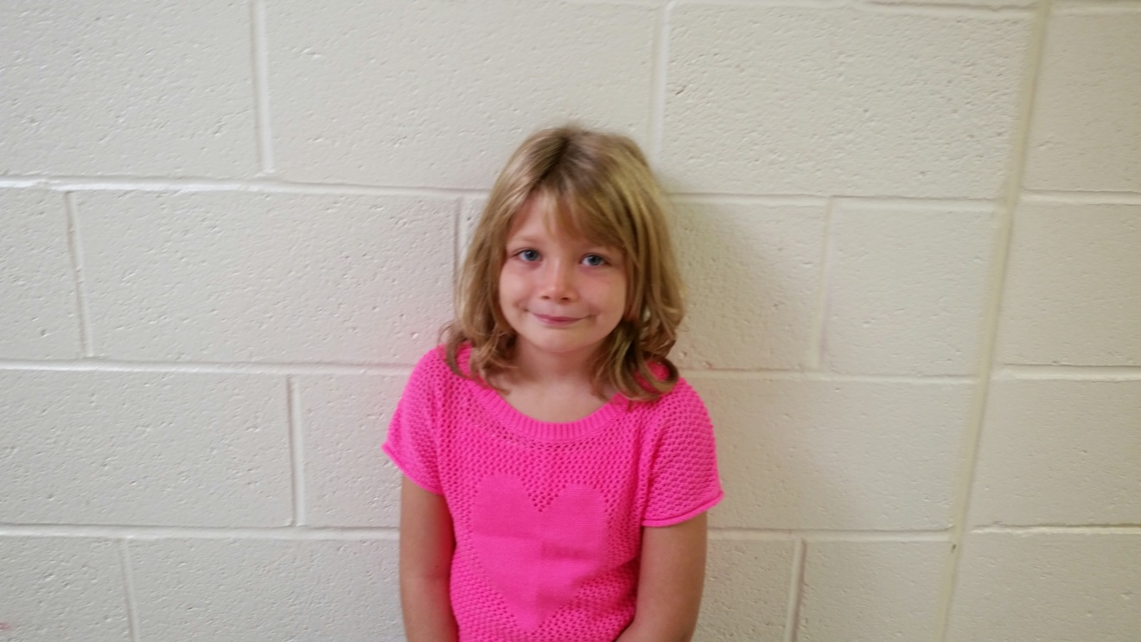
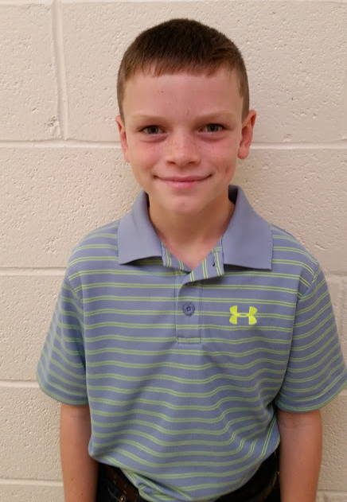
Spencer Chase Bierdeman
As you love God’s Word, may you have great peace and never stumble.
Psalm 119:65

Slide 13
Special Events
Movie Nights
Fall Festival
Advent- Carols, Cookies, Crafts
Lent- Egg Hunts
Table Talks
Intergenerational Class

Slide 14
Support Groups
Groups
Moms Groups
Grand parenting Groups
Young Family
Single Parents
Grieving Families
Curriculum Ideas
Convergence
Momastery
Moms Connect
MOPS

Slide 15
Resources
The Fall of Freddie the Leaf by Leo Buscaglia
Seamless Faith by Traci Smith
A Family Journey with Jesus through Lent by Angela Burrin
Grand Days by Group Publishing
Lord, Bless My Child by William & Nancie Carmichael
Family Faith Celebration: Milestone Kits: Baby Blessing, Faith Commitment, First Bible by Group Publishing
The Child in Christian Thought edited by Marcia J. Bunge

Slide 16
Resources
The Bible Uncensored, Children’s Ministry Magazine, April 2012, http://childrensministry.com/articles/the-bible-uncensored/
Beyond Noah’s Ark by Susan Garrett http://www.baylor.edu/ifl/christianreflection/childrenarticlegarrett.pdf
Practicing Our Faith at Home by Susan Briehl http://practicingourfaith.org/pdf/Practicing%20Our%20Faith%20at%20Home.pdf
31 Ways to Pray for Children by Bob Hosteltler https://finneyschool.org/LinkClick.aspx?fileticket=gsN6bSF_Elc%3D&tabid=289&mid=916
Practicing Examen with Children by Kimbrelee Conway Ireton http://www.kimberleeconwayireton.net/wp-content/uploads/2009/06/Practicing-the-Examen-with-Children.pdf
Bless your Kids Everyday by Brian Haynes, November 14, 2008 https://brianhaynes.org/2008/11/14/bless-your-kids-every-day/
Development Through the Lifespan http://www.umcdiscipleship.org/resources/development-through-the-life-span

