Slide 1
Best Practices for Virtual and Digital Ministry
John McNeill and Chris Sasser

Slide 2
Our Objectives & Plan
Provide space for reflection and encouragement
Provide space for community and dialogue
Provide space to share ideas about virtual and digital ministry

Slide 3
Our Objectives & Plan
Review Last Week
Devotion
Check-In/ Sharing
Presentation
Discussion: Q & A

Slide 4
Devotion Faithful Adaptation
Mark 2:2-5
I Love You (Lord Today) written by William Hubbard
Verse 1:
I love You, I love You, I love You, Lord, today;
Because You cared for me in such a special way.
That’s why I praise You, I lift You up, and I magnify Your name;
That’s why my heart is filled with praise.
Verse 2:
My heart, my mind, my soul belongs to You.
You paid the price for me way back on Calvary.
That’s why I praise You, I lift You up, and I magnify Your name;
That’s why my heart is filled with praise.
Oh yes that’s why my heart is filled with praise....

Slide 5
Small Group Check-in and Sharing
How are you and your family doing this week?
What are some ways you are seeing God moving in this season either at home or at church?

Slide 6
Best Practices for Virtual and Digital Ministry
Digital and Virtual Ministry
is not going away.
You have to have a digital presence!
“We want to be where they are.”
Digital: Instagram, You Tube, Tik Tok, Twitter
Virtual: Zoom, Google Hangout, FaceTime …

Slide 7
Best Practices for Virtual and Digital Ministry
Social Media Pitfall:
Just being a billboard to announce your events or share your thoughts.

Slide 8
ENGAGE

Slide 9
ENCOURAGE

Slide 10
ENCOURAGE

Slide 11
CELEBRATE

Slide 12
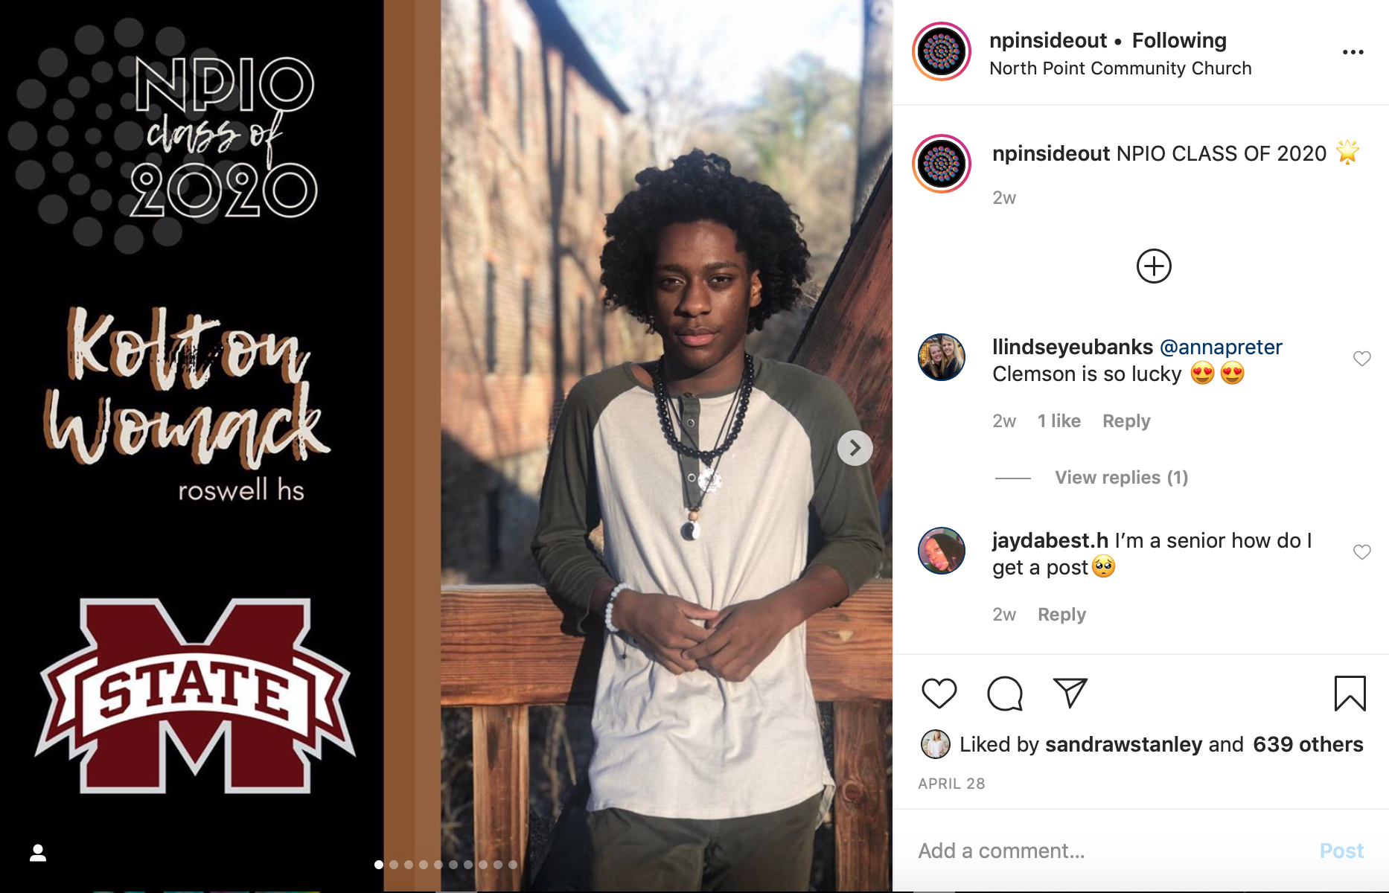
CELEBRATE

Slide 13
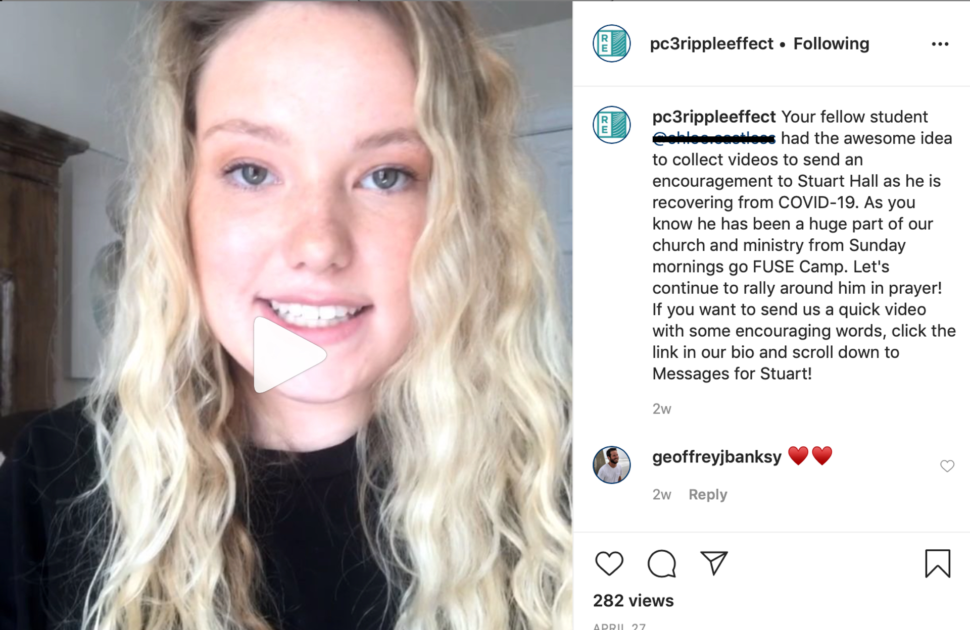
SERVE

Slide 14
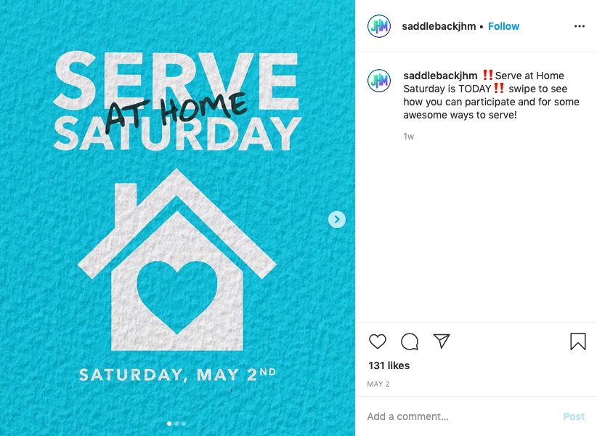
SERVE

Slide 15
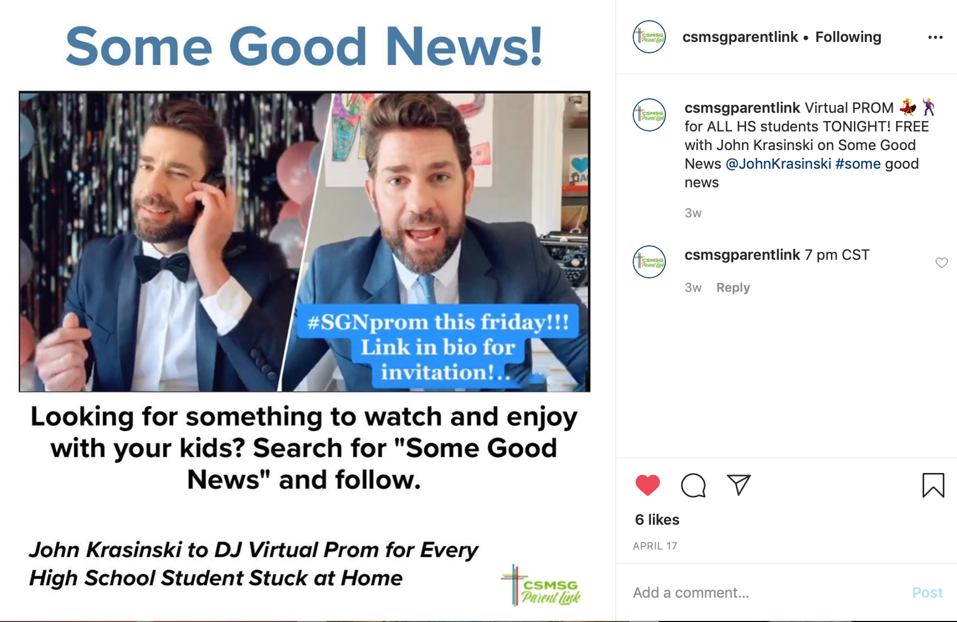
PARENTS

Slide 16
PARENTS

Slide 17
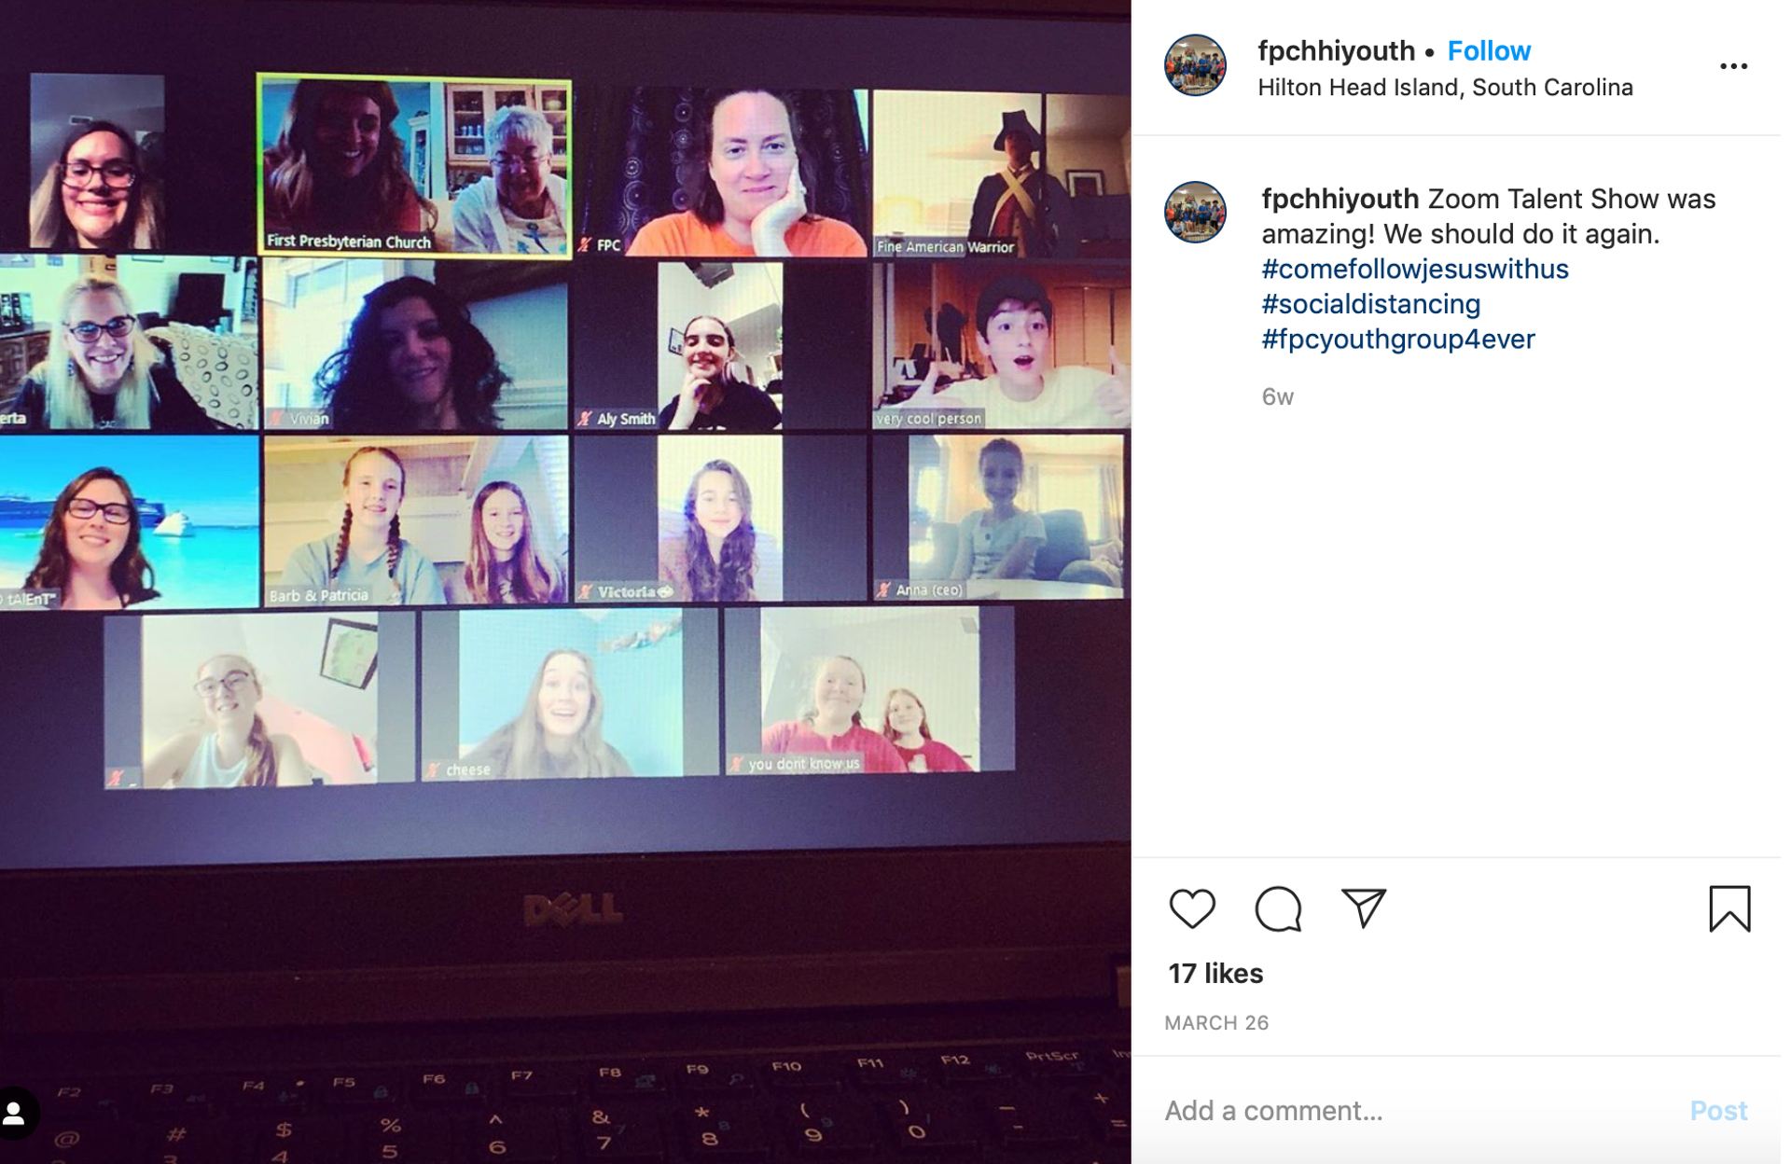
HAVE FUN!

Slide 18
HAVE FUN!

Slide 19
What people really need
CONNECTION
OVER
CONTENT

Slide 20
How we need to think
CUSTOMIZED
OVER
CORPORATE

Slide 21
Whole Group Conversation and Q&A
What are some things you are doing virtually and digitally that are working well?
What questions do you have or help do you need?

Slide 22
Best Practices for Virtual and Digital Ministry
John McNeill and Chris Sasser

